Slide 1
Data Structure and Algorithms-II
Analyzing Algorithms
Lecturer Saifur Rahman, Dept. of CSE, United International University

Slide 2
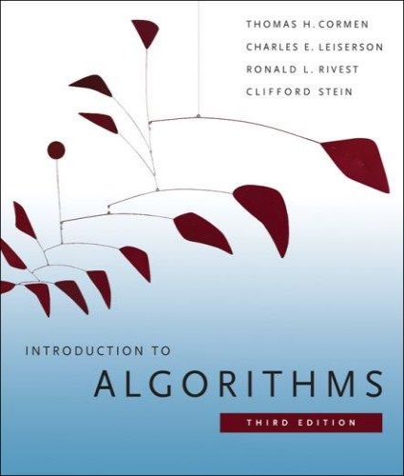
The Course
Purpose: a rigorous introduction to the design and analysis of algorithms
Not a programming course
Not a math course, either
Textbook: Introduction to Algorithms (3rd edition)
Cormen, Leiserson, Rivest, and Stein
An excellent reference you should own
Lecturer Saifur Rahman, Dept. of CSE, United International University

Slide 3
What is a Data Structure?
Data is a collection of facts, such as values, numbers, words, measurements, or observations.
Structure means a set of rules that holds the data together.
A data structure is a particular way of storing and organizing data in a computer so that it can be used efficiently.
Different kinds of data structures are suited to different kinds of applications, and some are highly specialized to specific tasks.
Data Structures provide a means to manage huge amount of data efficiently.
Usually, efficient data structures are a key to designing efficient algorithms.
Data structures can be nested.
Lecturer Saifur Rahman, Dept. of CSE, United International University

Slide 4
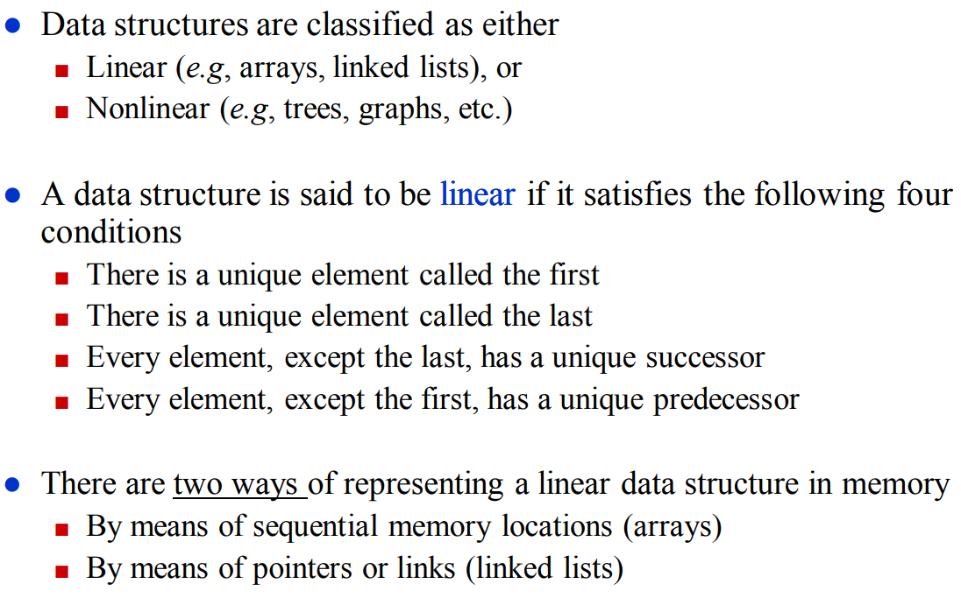
Types of Data Structures
Lecturer Saifur Rahman, Dept. of CSE, United International University

Slide 5
What is an Algorithm?
An algorithm is a sequence of computational steps that solves a well-specified computational problem.
An algorithm is said to be correct if, for every input instance, it halts with the correct output
An incorrect algorithm might not halt at all on some input instances, or it might halt with other than the desired output.
Lecturer Saifur Rahman, Dept. of CSE, United International University

Slide 6

What is a Program?
A program is the expression of an algorithm in a programming language
A set of instructions which the computer will follow to solve a problem
Lecturer Saifur Rahman, Dept. of CSE, United International University

Slide 7
Define a Problem, and Solve It
Problem:
Description of Input-Output relationship
Algorithm:
A sequence of computational steps that transform the input into the output.
Data Structure:
An organized method of storing and retrieving data.
Our Task:
Given a problem, design a correct and good algorithm that solves it.
Lecturer Saifur Rahman, Dept. of CSE, United International University

Slide 8
Define a Problem, and Solve It
Problem: Input is a sequence of integers stored in an array.
Output the minimum.
INPUT
Algorithm
OUTPUT
instance
m:= a[1];
for I:=2 to size of input
if m > a[i] then
m:=a[I];
return s
25, 90, 53, 23, 11, 34
11
m, a[i]
Data-Structure
Lecturer Saifur Rahman, Dept. of CSE, United International University

Slide 9
What do we Analyze?
Correctness
Does the input/output relation match algorithm requirement?
Amount of work done (complexity)
Basic operations to do task
Amount of space used
Memory used
Simplicity, clarity
Verification and implementation.
Optimality
Is it impossible to do better?
Lecturer Saifur Rahman, Dept. of CSE, United International University

Slide 10
Analyzing Algorithms
Asymptotic Notation
Analyzing Runtime
Lecturer Saifur Rahman, Dept. of CSE, United International University

Slide 11
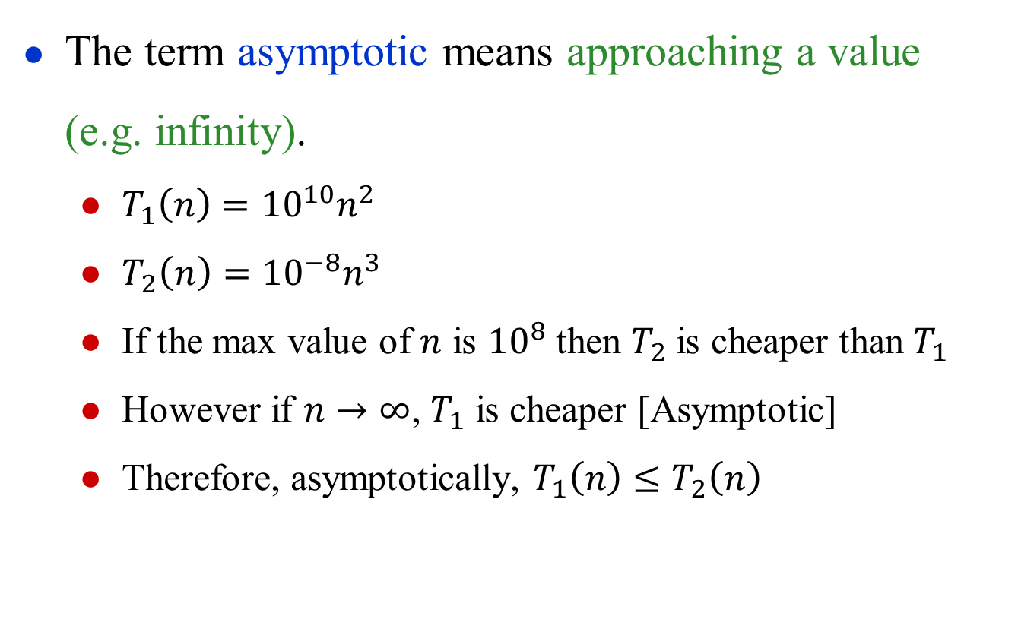
Asymptotic Analysis
The term asymptotic means approaching a value (e.g. infinity).
$T_{1}\left(n\right)={10}^{10}n^{2}$
$T_{2}\left(n\right)={10}^{−8}n^{3}$
If the max value of $n$ is ${10}^{8}$ then $T_{2}$ is cheaper than $T_{1}$
However if $n→∞$, $T_{1}$ is cheaper [Asymptotic]
Therefore, asymptotically, $T_{1}\left(n\right)≤T_{2}\left(n\right)$
Lecturer Saifur Rahman, Dept. of CSE, United International University

Slide 12
Asymptotic Analysis
Worst case
Provides an upper bound on running time
An absolute guarantee of required resources
Average case
Provides the expected running time
Very useful, but treat with care: what is “average”?
Random (equally likely) inputs
Real-life inputs
Best case
Lecturer Saifur Rahman, Dept. of CSE, United International University

Slide 13
Upper Bound Notation
We say InsertionSort’s run time is O(n²)
Properly we should say run time is in O(n²)
Read O as “Big-O” (you’ll also hear it as “order”)
In general a function
f(n) is O(g(n)) if there exist positive constants c and n₀ such that 0 ≤ f(n) ≤ c ⋅ g(n) for all n ≥ n₀
Formally
O(g(n)) = { f(n): ∃ positive constants c and n₀ such that 0 ≤ f(n) ≤ c ⋅ g(n) ∀ n ≥ n₀ }
Lecturer Saifur Rahman, Dept. of CSE, United International University

Slide 14
Upper Bound Notation
c.g(n)
time
f(n)
n₀
n
We say g(n) is an asymptotic upper bound for f(n)
Lecturer Saifur Rahman, Dept. of CSE, United International University

Slide 15
Insertion Sort is O(n²)
Proof
The run-time is an² + bn + c
If any of a, b, and c are less than 0, replace the constant with its absolute value
an² + bn + c ≤ (a + b + c)n² + (a + b + c)n + (a + b + c)
≤ 3(a + b + c)n² for n ≥ 1
Let c’ = 3(a + b + c) and let n₀ = 1. Then
an² + bn + c ≤ c’ n² for n ≥ 1
Thus an² + bn + c = O(n²).
Question
Is InsertionSort O(n³) ?
Is InsertionSort O(n) ?
Lecturer Saifur Rahman, Dept. of CSE, United International University

Slide 16
Lower Bound Notation
We say InsertionSort’s run time is Ω(n)
In general a function
f(n) is Ω(g(n)) if ∃ positive constants c and n₀ such that 0 ≤ c⋅g(n) ≤ f(n) ∀ n ≥ n₀
Proof:
Suppose run time is an + b
Assume a and b are positive
an ≤ an + b
Lecturer Saifur Rahman, Dept. of CSE, United International University

Slide 17
Lower Bound Notation
f(n)
time
c.g(n)
n₀
n
We say g(n) is an asymptotic lower bound for f(n)
Lecturer Saifur Rahman, Dept. of CSE, United International University

Slide 18
Asymptotic Tight Bound
A function f(n) is Θ(g(n)) if ∃ positive constants c₁, c₂, and n₀ such that 0 ≤ c₁ g(n) ≤ f(n) ≤ c₂ g(n) ∀ n ≥ n₀
Theorem
f(n) is Θ(g(n)) iff f(n) is both O(g(n)) and Ω(g(n))
Proof:
Lecturer Saifur Rahman, Dept. of CSE, United International University

Slide 19
Asymptotic Tight Bound
c₂.g(n)
f(n)
time
c₁.g(n)
n₀
n
We say g(n) is an asymptotic tight bound for f(n)
Lecturer Saifur Rahman, Dept. of CSE, United International University

Slide 20
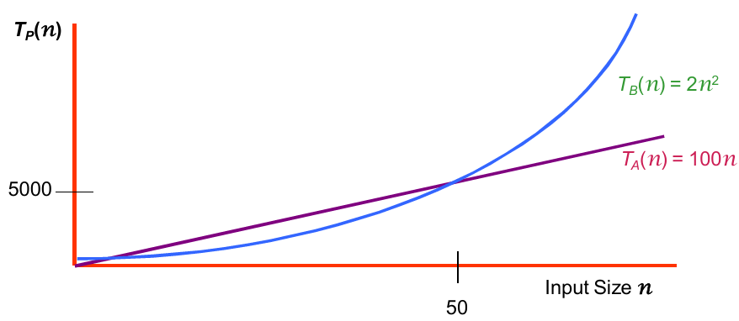
Practical Complexity
For large input sizes, constant terms are insignificant
Program A with running time T_{A}(n)= 100n
Program B with running time T_{B}(n)= 2n²
Lecturer Saifur Rahman, Dept. of CSE, United International University
Notes:
20

Slide 21
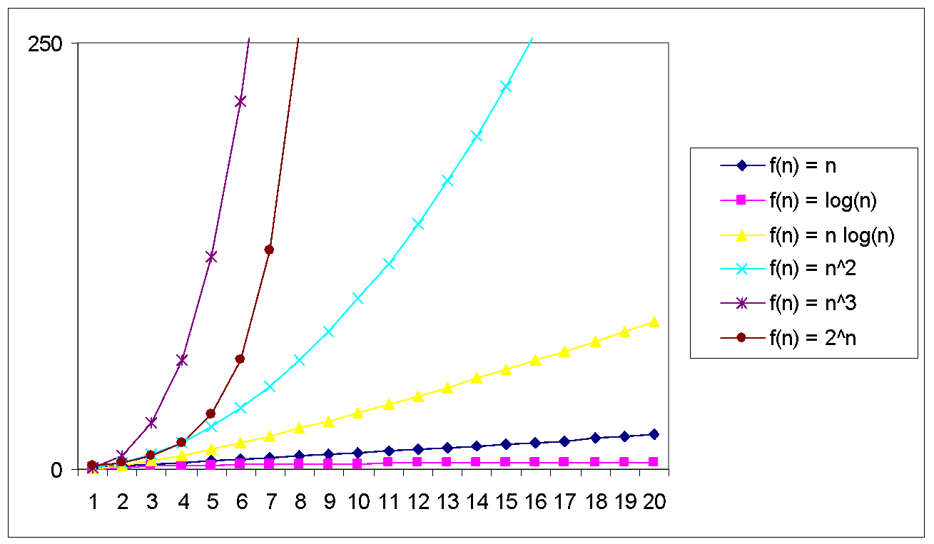
Practical Complexity
Lecturer Saifur Rahman, Dept. of CSE, United International University

Slide 22
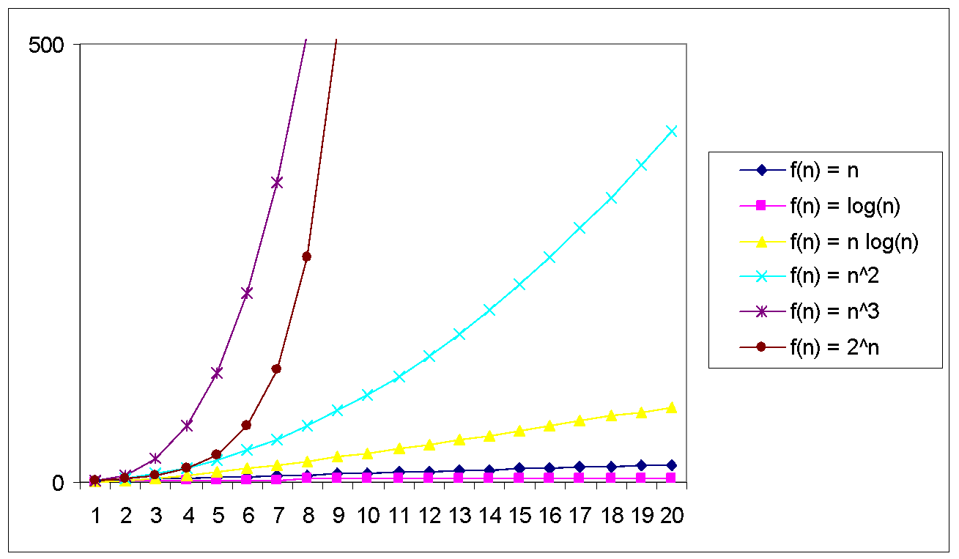
Practical Complexity
Lecturer Saifur Rahman, Dept. of CSE, United International University

Slide 23
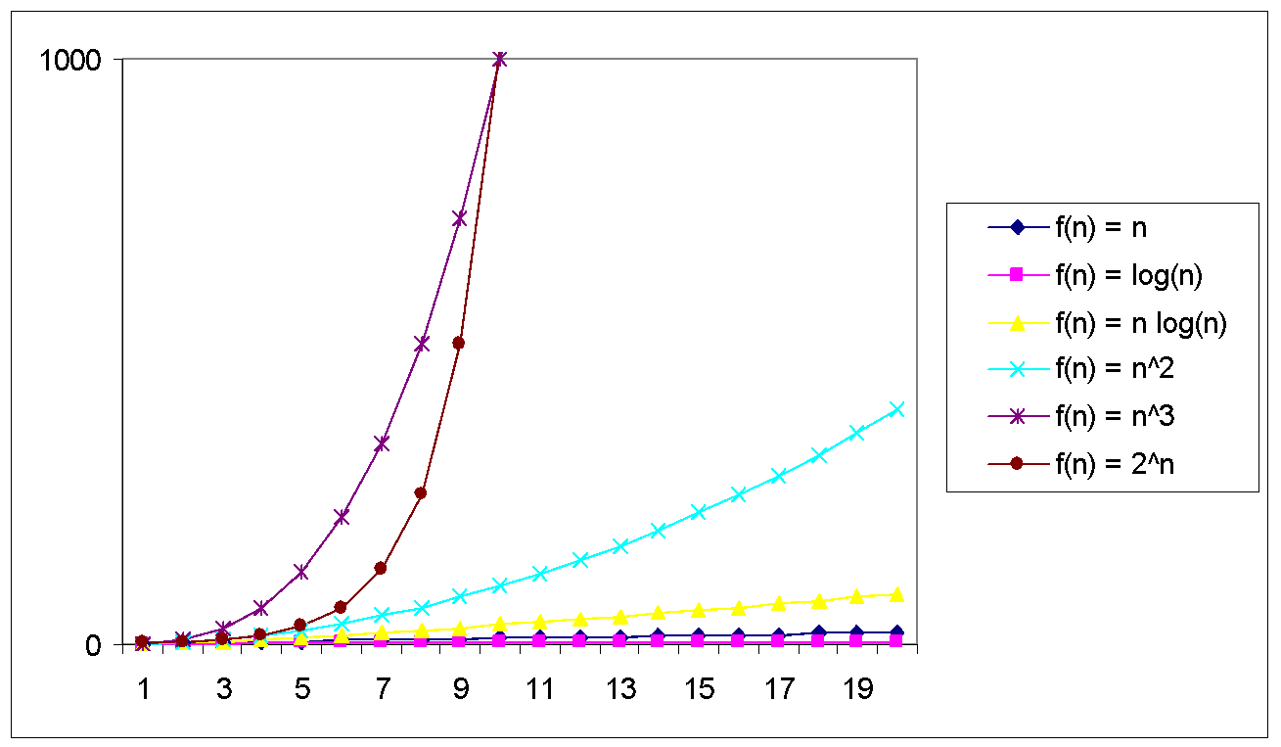
Practical Complexity
Lecturer Saifur Rahman, Dept. of CSE, United International University

Slide 24
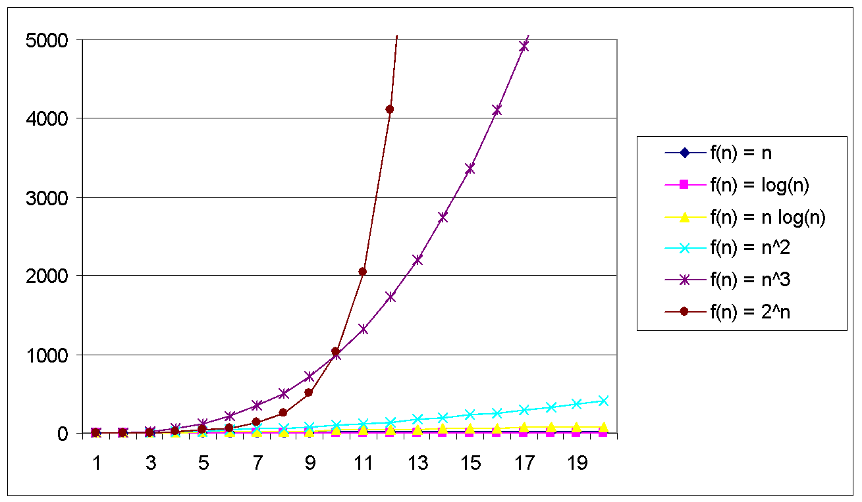
Practical Complexity
Lecturer Saifur Rahman, Dept. of CSE, United International University

Slide 25
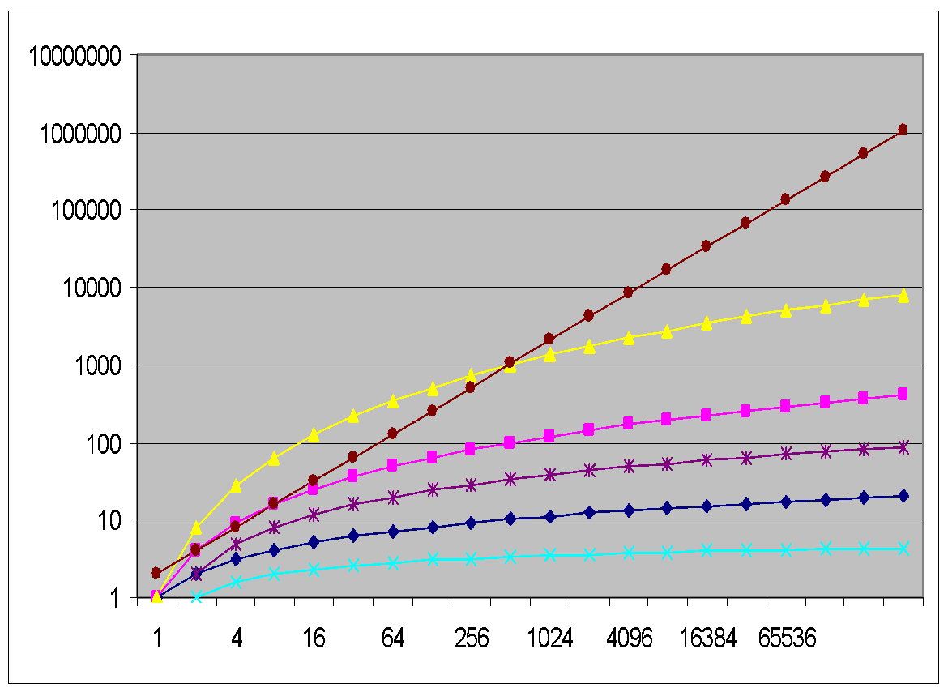
Practical Complexity
f(n) = n
f(n) = log(n)
f(n) = n log(n)
f(n) = n^2
f(n) = n^3
f(n) = 2^n
Lecturer Saifur Rahman, Dept. of CSE, United International University

Slide 26
Practical Complexity
Function | Descriptor | Big-Oh
c | Constant | O( 1 )
log n | Logarithmic | O( log n )
n | Linear | O( n )
n log n | n log n | O( n log n )
n² | Quadratic | O( n² )
n³ | Cubic | O( n³ )
n^{k} | Polynomial | O( n^{k} )
2^{n} | Exponential | O( 2^{n} )
n! | Factorial | O( n! )
Lecturer Saifur Rahman, Dept. of CSE, United International University

Slide 27
Other Asymptotic Notations
A function f(n) is o(g(n)) if ∃ positive constants c and n₀ such that f(n) < c g(n) ∀ n ≥ n₀
A function f(n) is ω(g(n)) if ∃ positive constants c and n₀ such that c g(n) < f(n) ∀ n ≥ n₀
Intuitively,
o( ) is like <
O( ) is like ≤
ω( ) is like >
Ω( ) is like ≥
Θ( ) is like =
Lecturer Saifur Rahman, Dept. of CSE, United International University

Slide 28

Other Asymptotic Notations
Assume: $T\left(n\right)=5n^{3}+4n+1$, $g\left(n\right)=n^{3}$
$T\left(n\right)$ is $O\left(n^{3}\right)$
$T(n)$ is $Ω\left(n^{3}\right)$
$T(n)$ is $Θ\left(n^{3}\right)$
$T\left(n\right)$ is $O\left(n^{7}\right) \left(n\right)$ is $O\left(n^{7}\right)$
$T(n)$ is $Θ\left(n^{2}\right)$
Lecturer Saifur Rahman, Dept. of CSE, United International University

Slide 29
Exact cost analysis
best and worst case analysis
Lecturer Saifur Rahman, Dept. of CSE, United International University

Slide 30
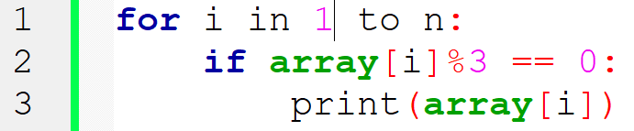
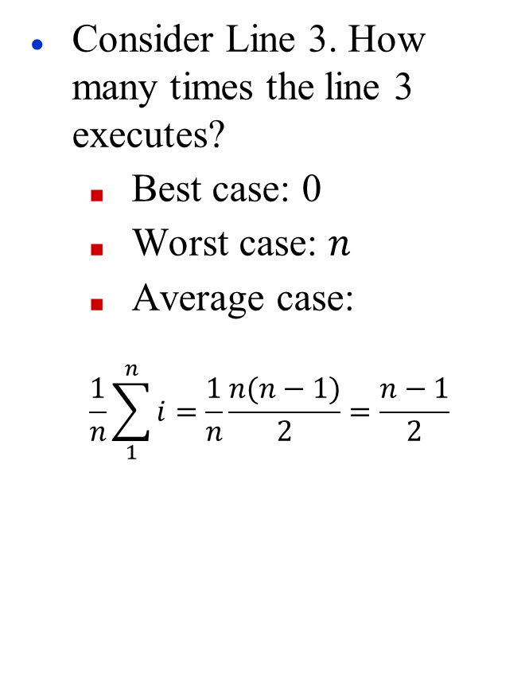
Exact Cost Analysis: Example 1
Consider Line 3. How many times the line 3 executes?
Best case: 0
Worst case: $n$
Average case:
$$\frac{1}{n}\sum_{1}^{n}{i}=\frac{1}{n}\frac{n(n−1)}{2}=\frac{n−1}{2}$$
Lecturer Saifur Rahman, Dept. of CSE, United International University

Slide 31

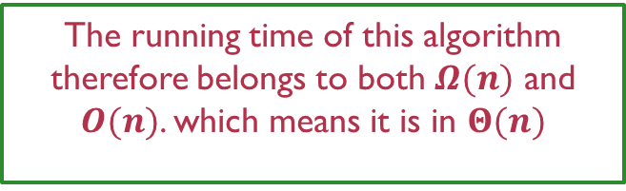
Exact Cost Analysis: Example 1
Consider Line 3. How many times the line 3 executes?
Best case: 0
Worst case: $n$
Average case:
$$\frac{1}{n}\sum_{1}^{n}{i}=\frac{1}{n}\frac{n(n+1)}{2}=\frac{n+1}{2}$$
The running time of this algorithm therefore belongs to both $Ω(n)$ and $O(n)$. which means it is in $Θ(n)$
d $O(n)$. which means it is in $Θ(n)$
Lecturer Saifur Rahman, Dept. of CSE, United International University

Slide 32
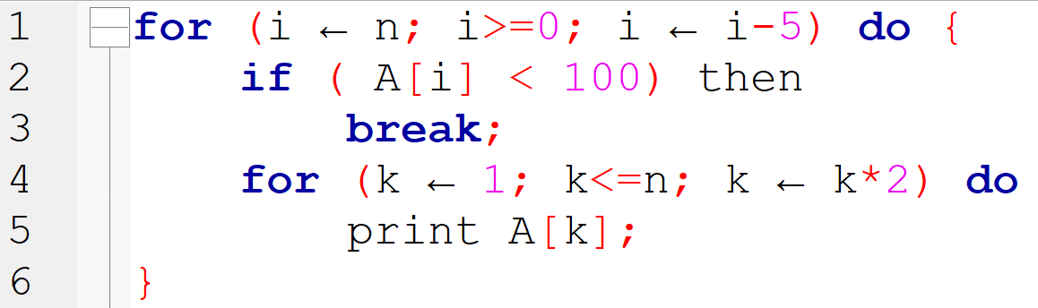
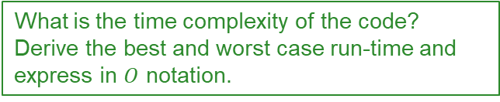
Exact Cost Analysis: Example 2
Line | Worst | Best
1
2
3
4
5
Asymptotic
What is the time complexity of the code? Derive the best and worst case run-time and express in $O$ notation.
Lecturer Saifur Rahman, Dept. of CSE, United International University

Slide 33
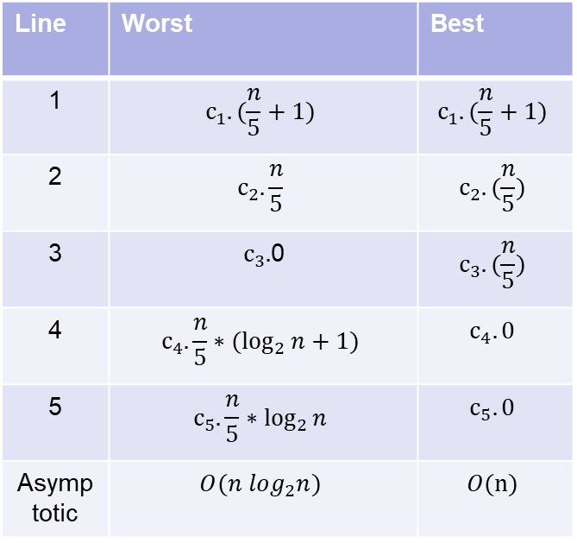
Exact Cost Analysis: Example 2
Line | Worst | Best
1 | $$c_{1}.(\frac{n}{5}+1)$$ | $$c_{1}.(\frac{n}{5}+1)$$
2 | $$c_{2}.\frac{n}{5}$$ | $$c_{2}.(\frac{n}{5})$$
3 | $c_{3}.$0 | $$c_{3}.(\frac{n}{5})$$
4 | $$c_{4}.\frac{n}{5}∗(\log_{2}{n}+1)$$ | $$c_{4}.0$$
5 | $$c_{5}.\frac{n}{5}∗\log_{2}{n}$$ | $$c_{5}.0$$
Asymptotic | $$O(n log_{2}n)$$ | $$O(n)$$
Lecturer Saifur Rahman, Dept. of CSE, United International University

Slide 34
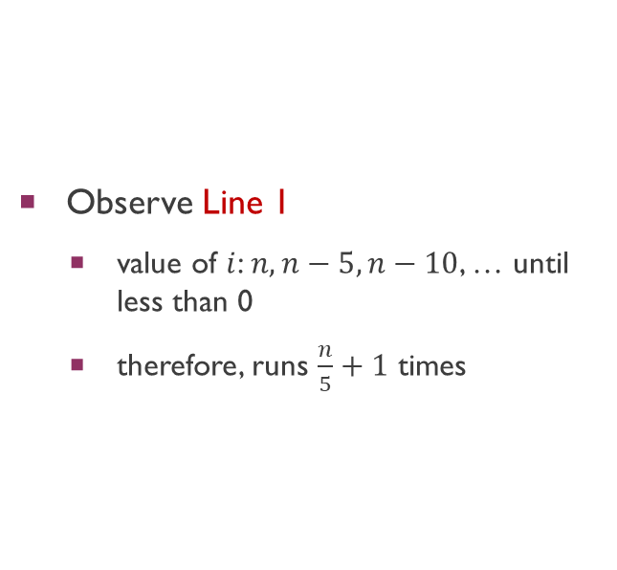
Exact Cost Analysis: Example 2
Lecturer Saifur Rahman, Dept. of CSE, United International University

Slide 35
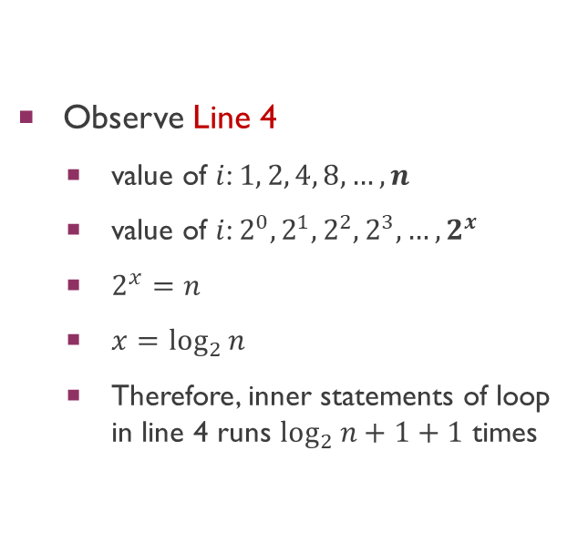
Exact Cost Analysis: Example 2
Lecturer Saifur Rahman, Dept. of CSE, United International University

Slide 36
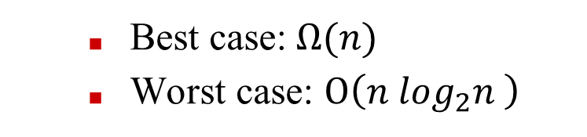
Exact Cost Analysis: Example 2
Best case:$Ω(n)$
Worst case: $O\left(n \log_{2}n \right)$
The running time of this algorithm therefore belongs to both $Ω(n)$ and $O\left(n \log_{2}n \right)$
Lecturer Saifur Rahman, Dept. of CSE, United International University

Slide 37
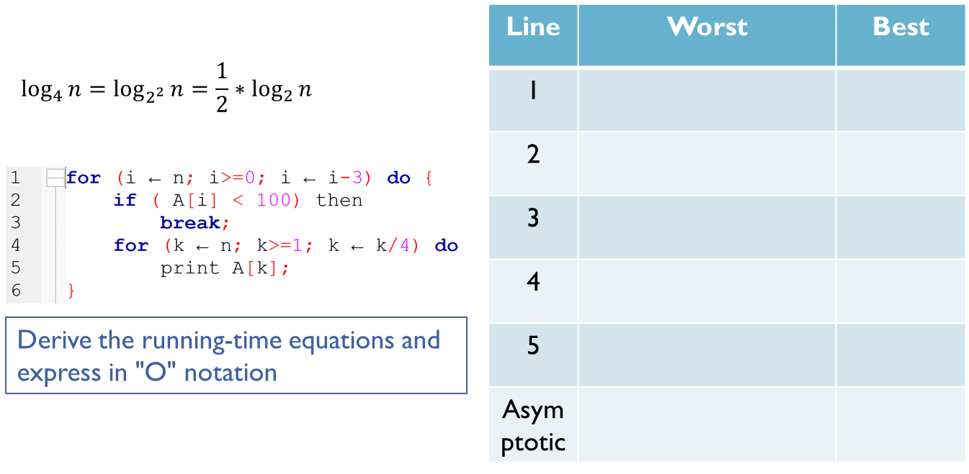
Exact Cost Analysis: Example 3
Lecturer Saifur Rahman, Dept. of CSE, United International University

Slide 38
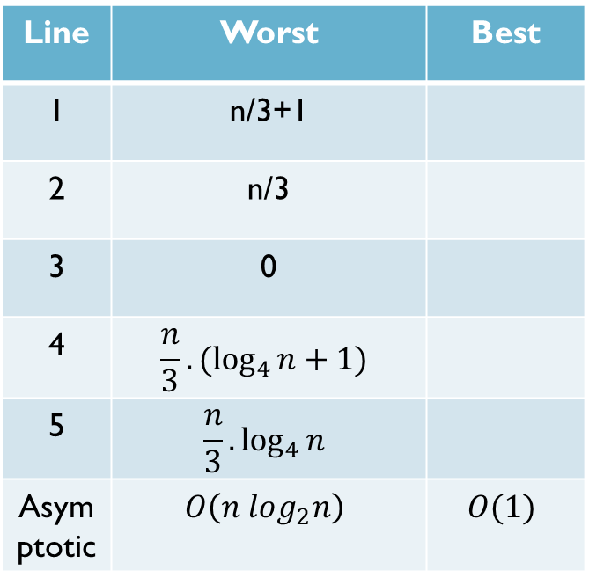
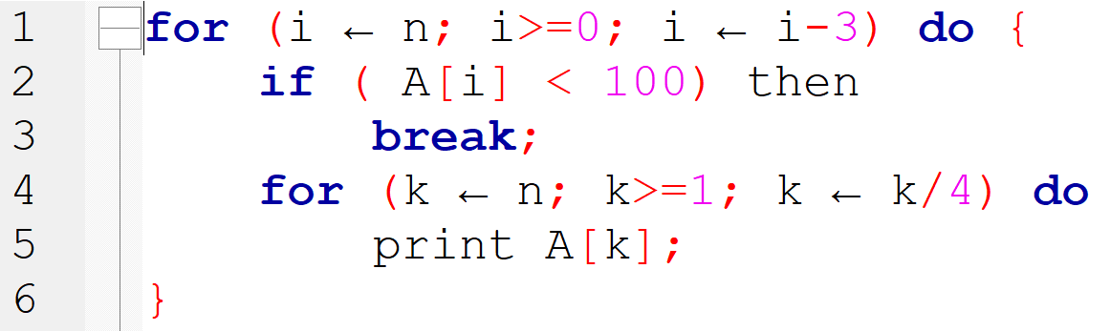


Exact Cost Analysis: Example 3
$$\log_{4}{n}=\log_{2^{2}}{n}=\frac{1}{2}∗\log_{2}{n}$$
Lecturer Saifur Rahman, Dept. of CSE, United International University

Slide 39
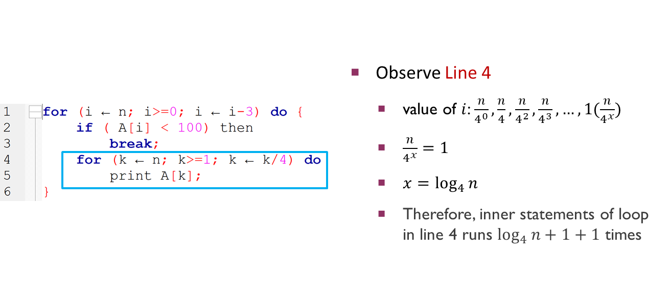
Exact Cost Analysis: Example 3
Lecturer Saifur Rahman, Dept. of CSE, United International University

Slide 40
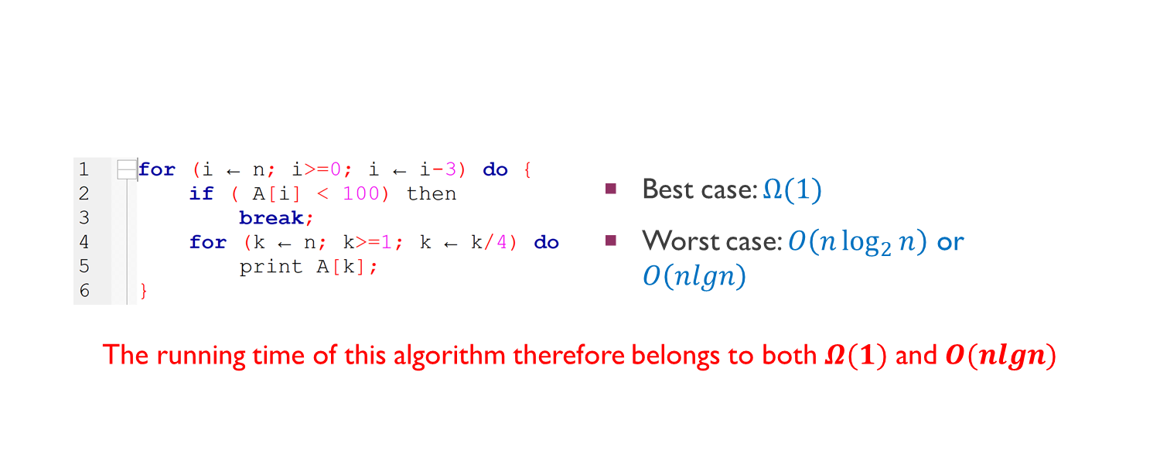


Exact Cost Analysis: Example 3
Lecturer Saifur Rahman, Dept. of CSE, United International University

Slide 41
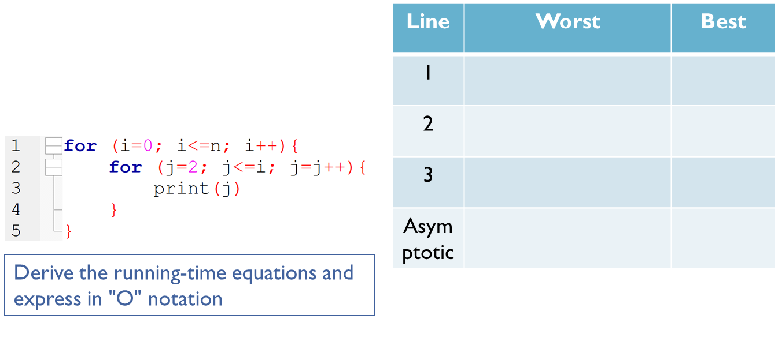
Exact Cost Analysis: Example 4
Lecturer Saifur Rahman, Dept. of CSE, United International University

Slide 42
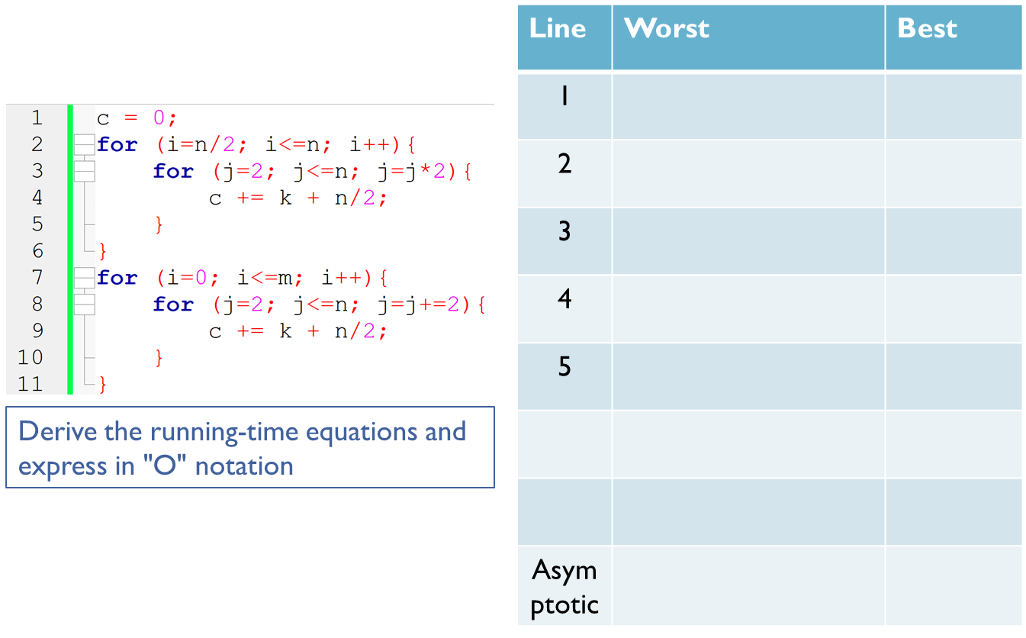
Exact Cost Analysis: Example 5
Lecturer Saifur Rahman, Dept. of CSE, United International University

Slide 43
Practice
Lecturer Saifur Rahman, Dept. of CSE, United International University

Slide 44
Question Patterns
Derive the best and worst-case running-time equations and express them in O notation.
Derive the exact cost equation and express it in O notation
Provide best and worst-case examples
Lecturer Saifur Rahman, Dept. of CSE, United International University

Slide 45
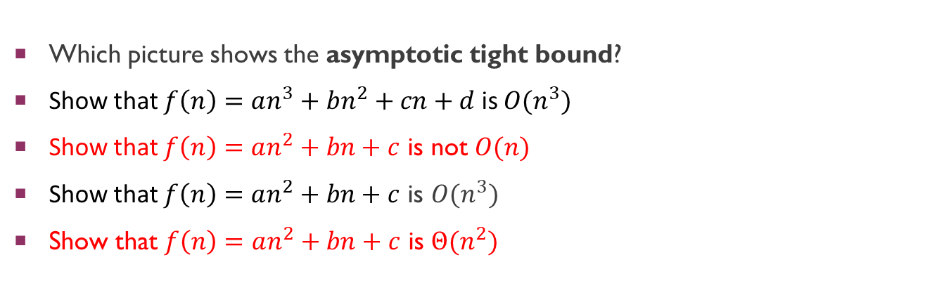
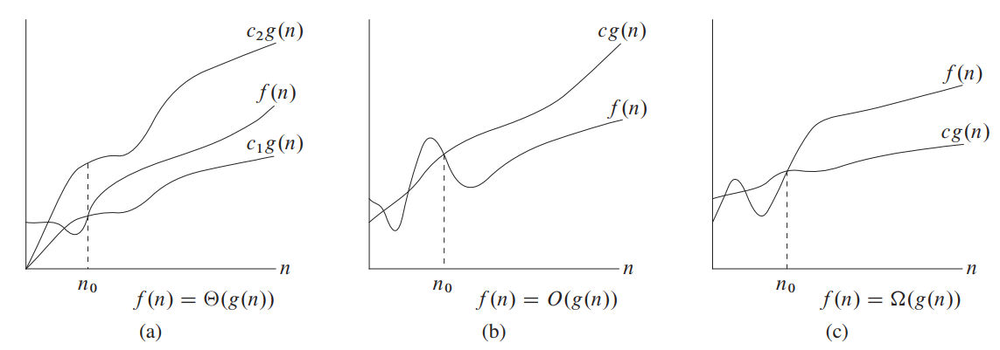
Quick Evaluation 1
Lecturer Saifur Rahman, Dept. of CSE, United International University

Slide 46
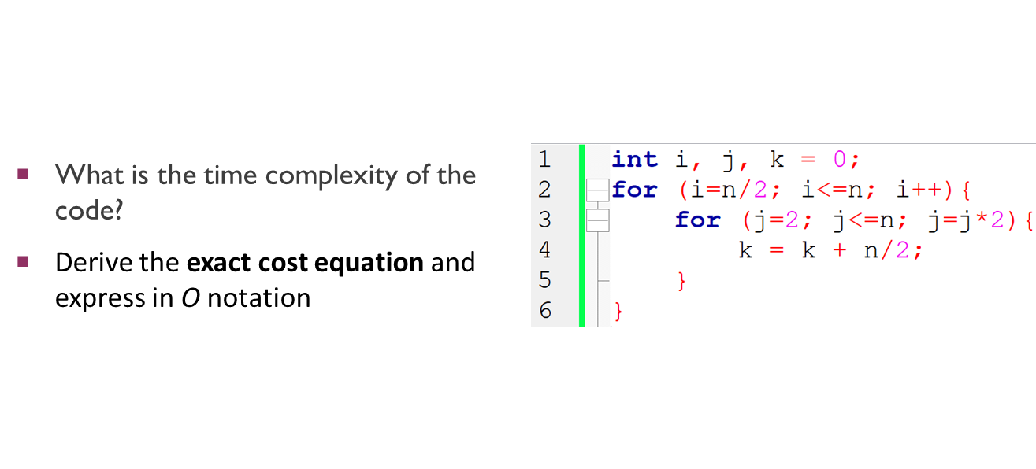
Quick Evaluation 2
Lecturer Saifur Rahman, Dept. of CSE, United International University

Slide 47
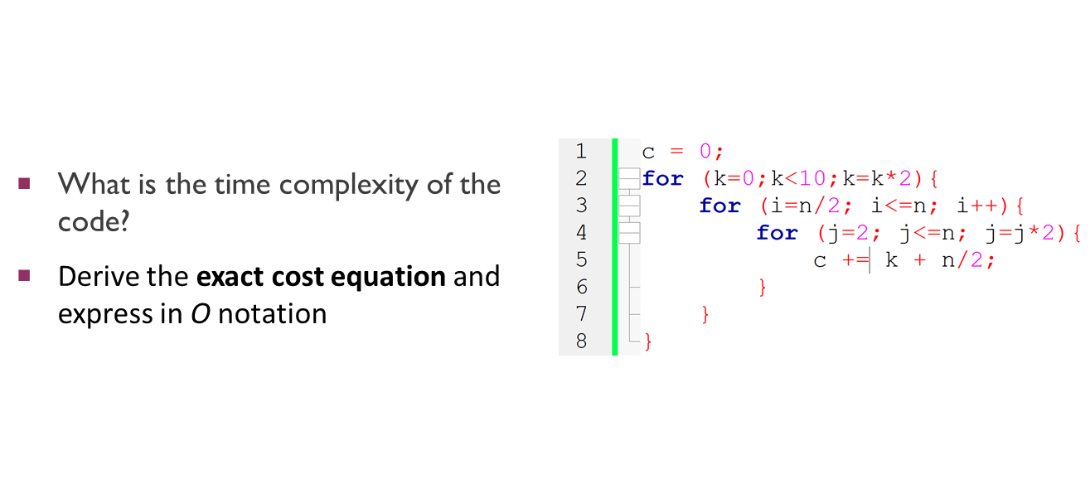
Quick Evaluation 3
Lecturer Saifur Rahman, Dept. of CSE, United International University

Slide 48
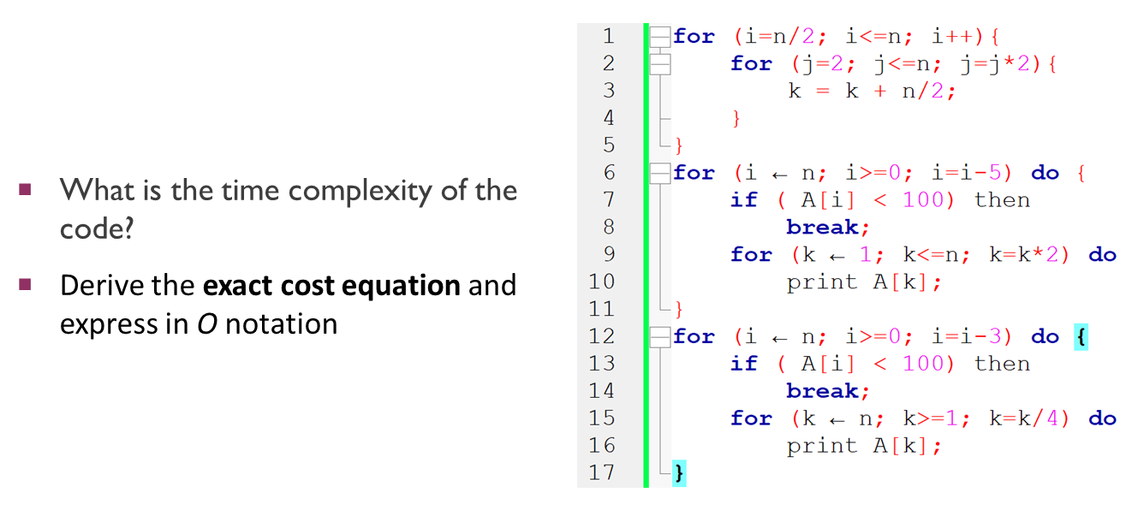
Quick Evaluation 4
Lecturer Saifur Rahman, Dept. of CSE, United International University

Slide 49
Resources
https://www.cs.auckland.ac.nz/courses/compsci220s1t/lectures/lecturenotes/GG-lectures/BigOhexamples.pdf
http://www.cs.utsa.edu/~bylander/cs3233/big-oh.pdf
https://youtu.be/FEnwM-iDb2g
https://stackoverflow.com/questions/11227809/why-is-processing-a-sorted-array-faster-than-processing-an-unsorted-array/11227902#11227902
Lecturer Saifur Rahman, Dept. of CSE, United International University

